Slide 1

Clothing E-Commerce Data Optimization System
Group-1 :Database Management System
Nathalie De Vicente De Azcarreta, Haley Badillo, Enrique Nagatani Rossi, Jimmy Zabala, Amrutha Roy Natla and Vaishnavi Kothamirkar

Slide 2

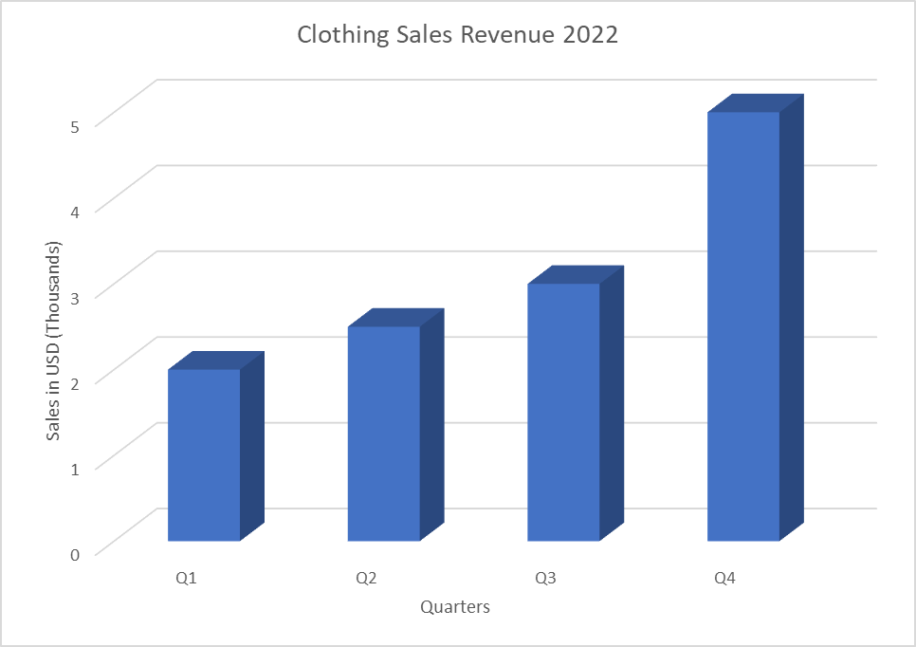
Business Scenario
Client’s Pain Point
A startup retail company is growing exponentially- this clothing e-commerce business found that using Excel to manage its data is becoming too problematic. In its expansion, they need a holistic database application that can help track inventory, sales and customer information.

Slide 3
Purpose
The purpose of our SQL Database Proposal is to help our client manage their business data more efficiently and effectively, in order to make more informed decisions and optimize reporting and analytics.
Efficiency, Accuracy & Data Integrity
Track Inventory Levels
Record Sales Transactions
Track Customer Information
Reporting & Analysis

Slide 4
Questions the Database will answer:
What Products are in Stock and how many units of each product do I have?
What Products have been sold and how much revenue have they generated?
What are the best selling products? Which customers have the highest ARPU?
What is the sales trend overtime, per quarter, per year?
Which are my slowest-selling products? Should I consider discontinuing such product?

Slide 5
Assumptions & Business Rules
Each customer is assigned a unique CustomerID which is utilized for a loyalty program- to track overall spending in orders and encourage further purchases
Each product has an individual SKU, orders can be compiled of many different products
Loyalty Program- 4 Tiers
Bronze = < $100 spent
Silver = Between $100 and $200 spent
Gold = Between $200 and $300 spent
Platinum: $300+ spent
Due to the nature of our business scenario, a given employee will process more than one order, but a given order will be processed by one employee

Slide 6
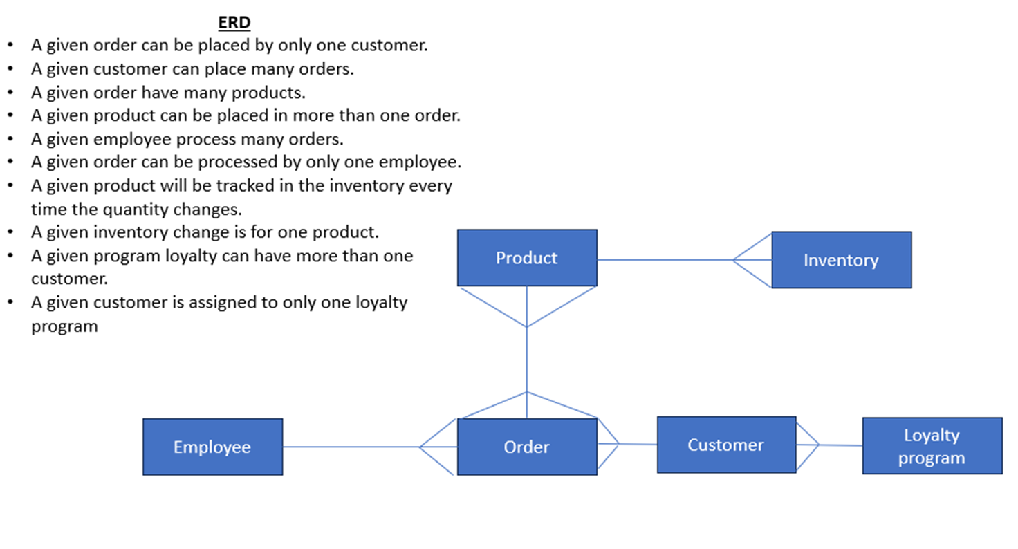

Slide 7
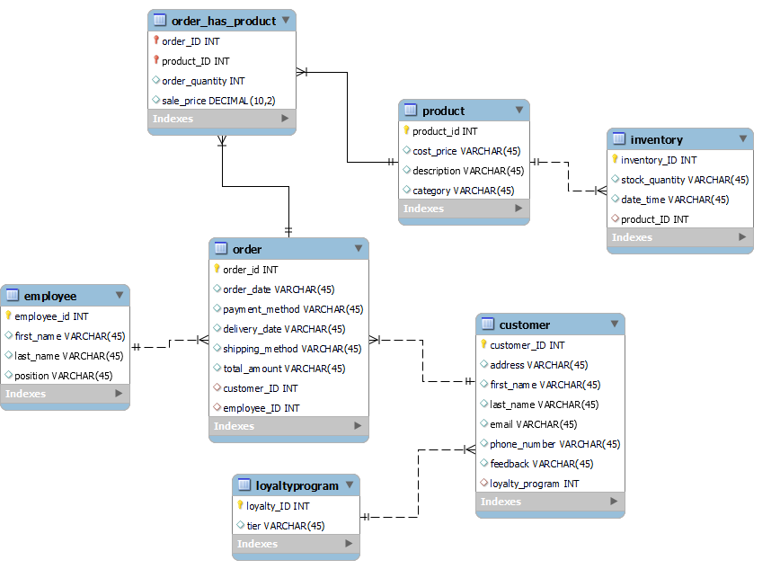
Logical Schema

Slide 8
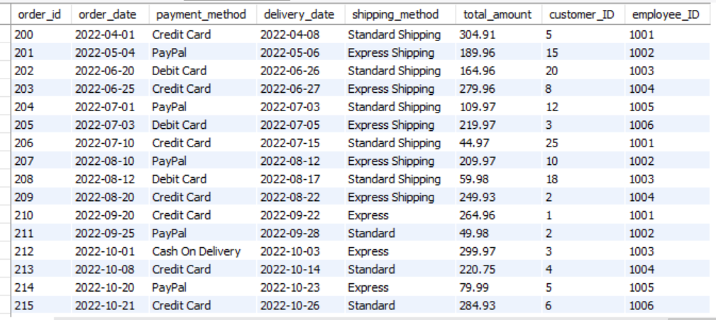
Order table

Slide 9
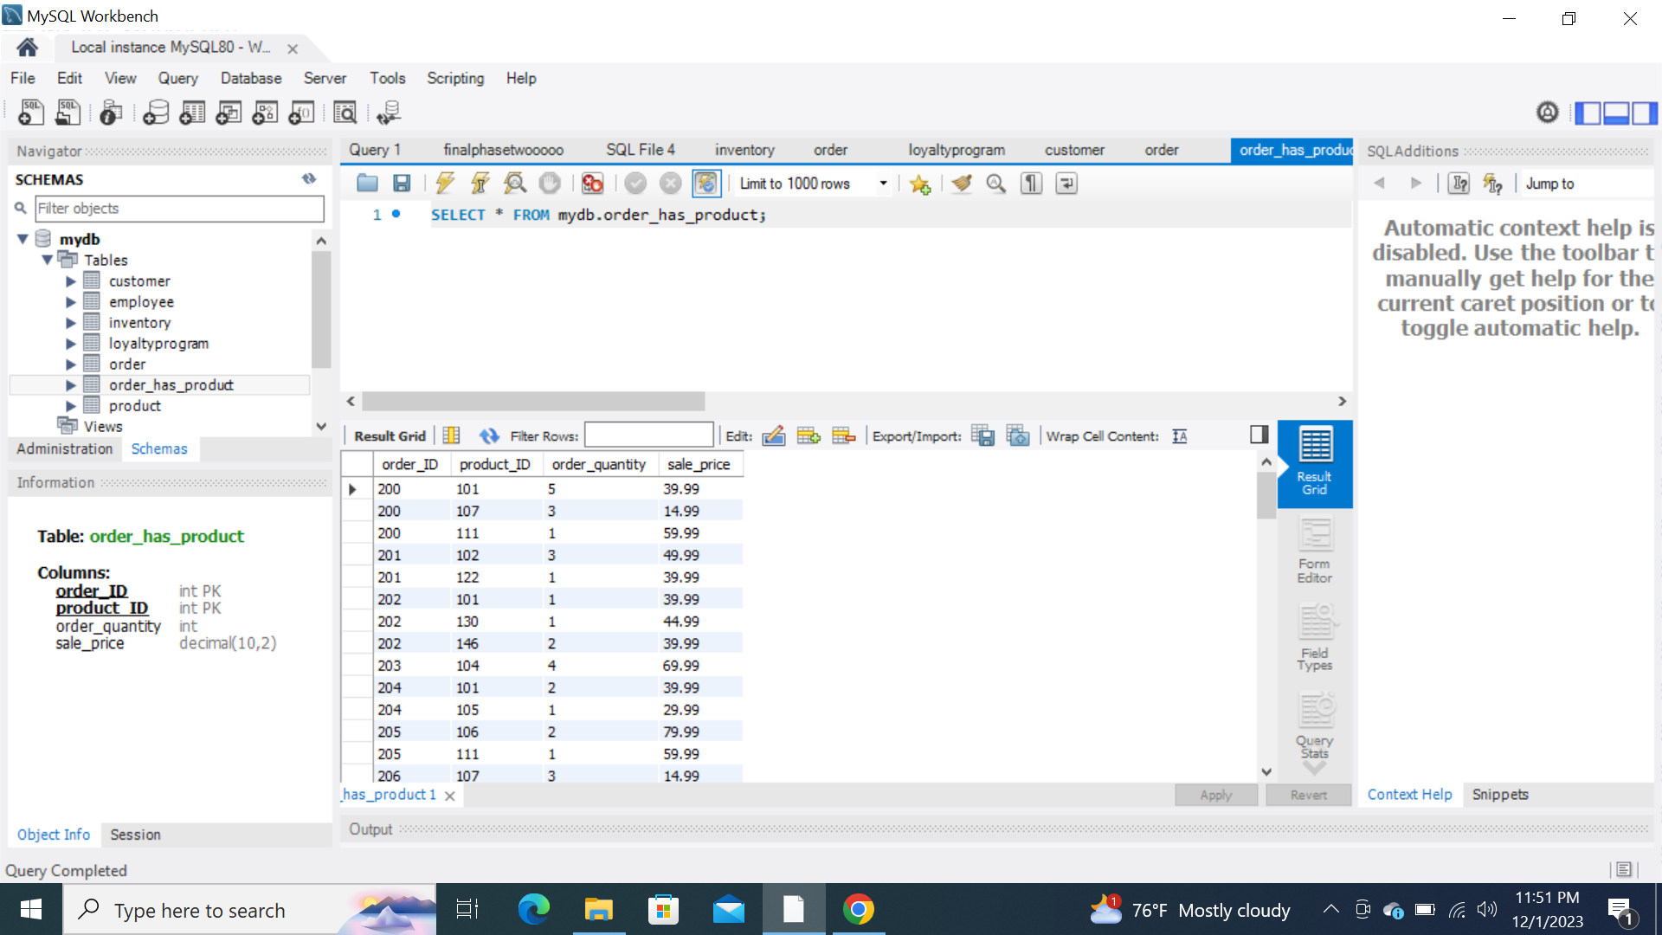
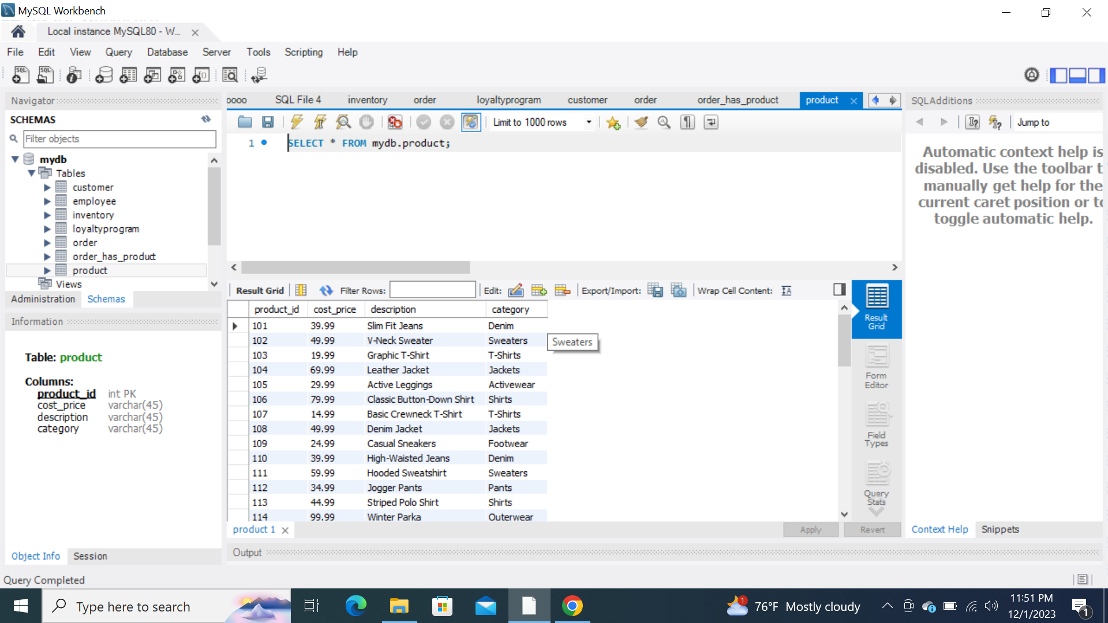
Order_has_product table
Product table

Slide 10
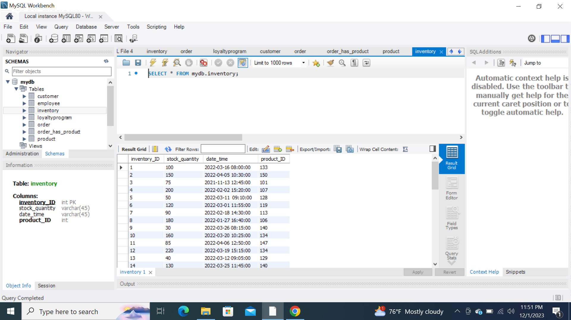
Inventory table

Slide 11
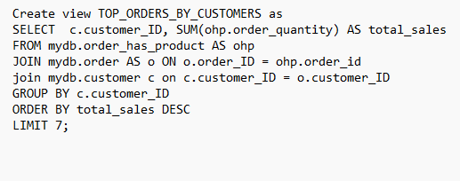
View (Top Customers)

Slide 12
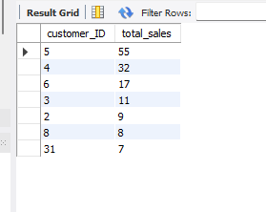
View (Top Customers)

Slide 13
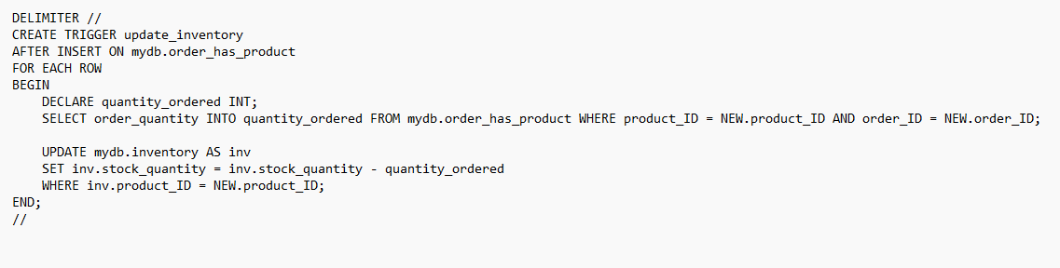
Trigger (inventory)

Slide 14
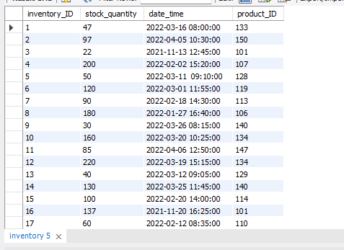
Trigger (inventory)

Slide 15
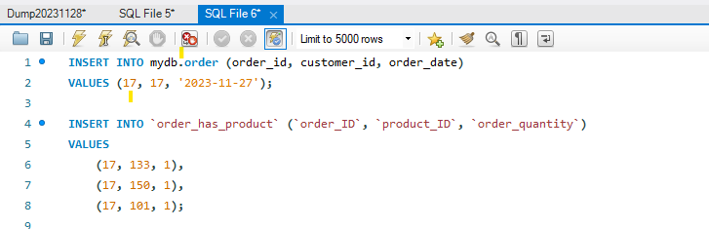
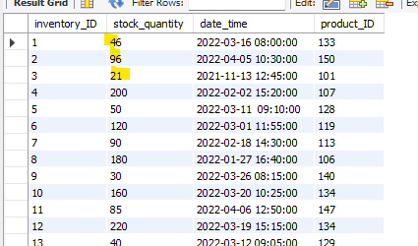
Trigger (inventory)

Slide 16
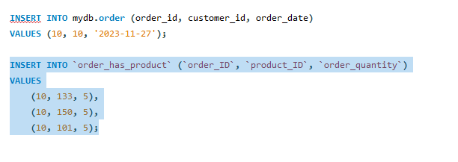
Trigger (inventory)

Slide 17
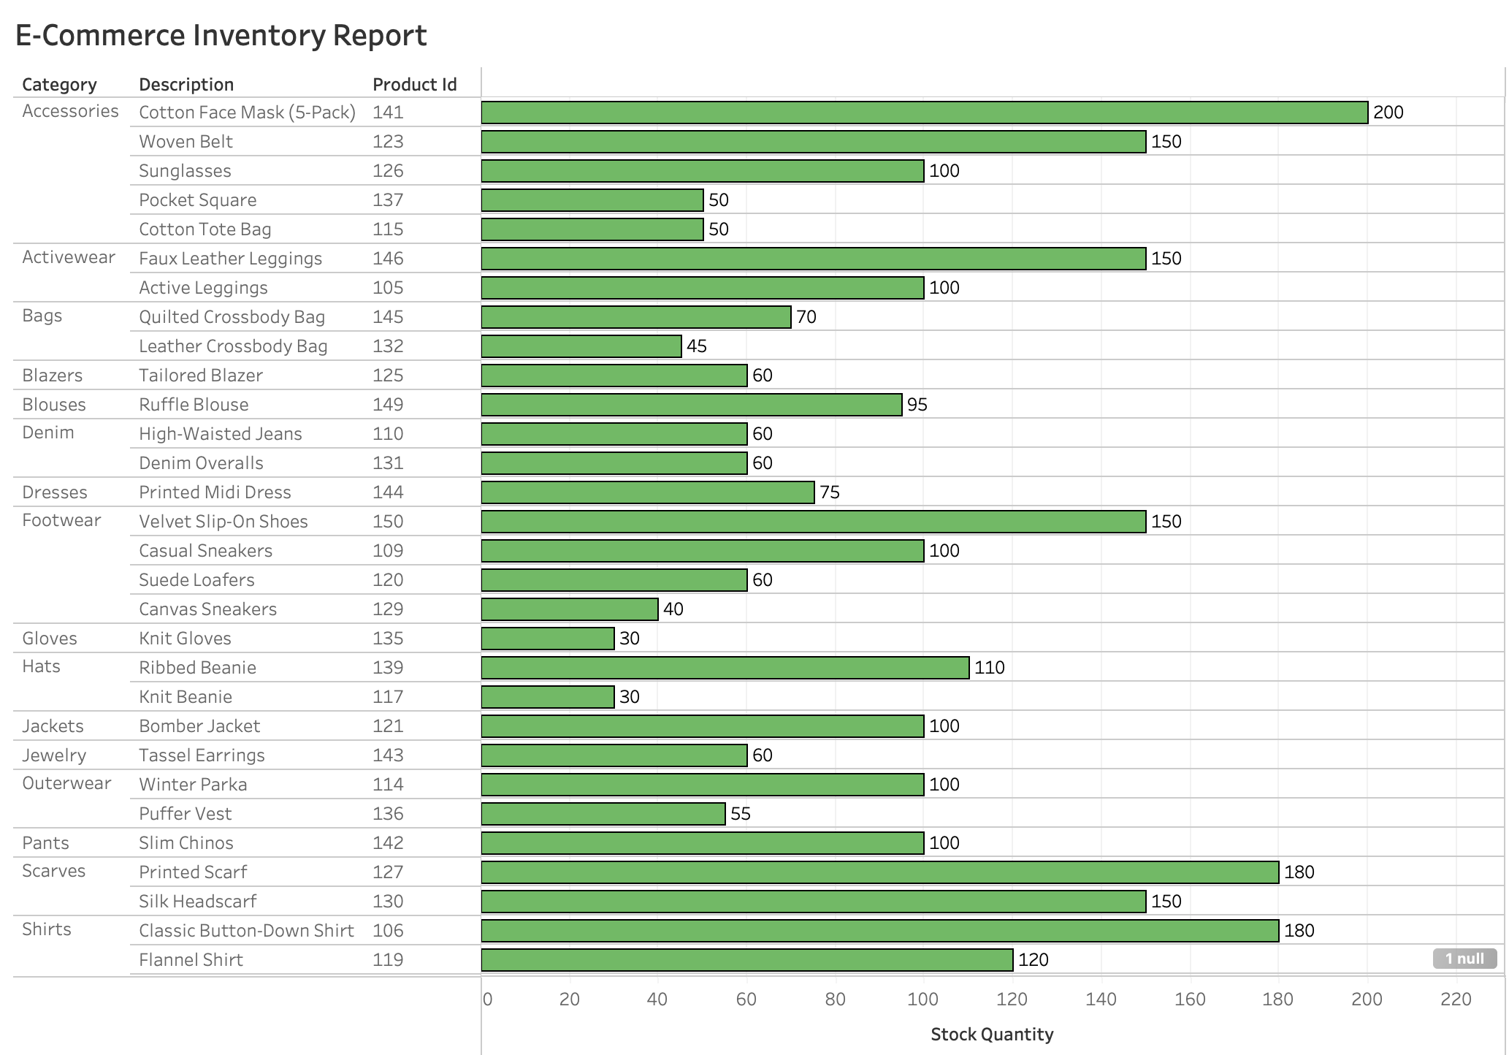
Business Intelligence Reports:

Slide 18
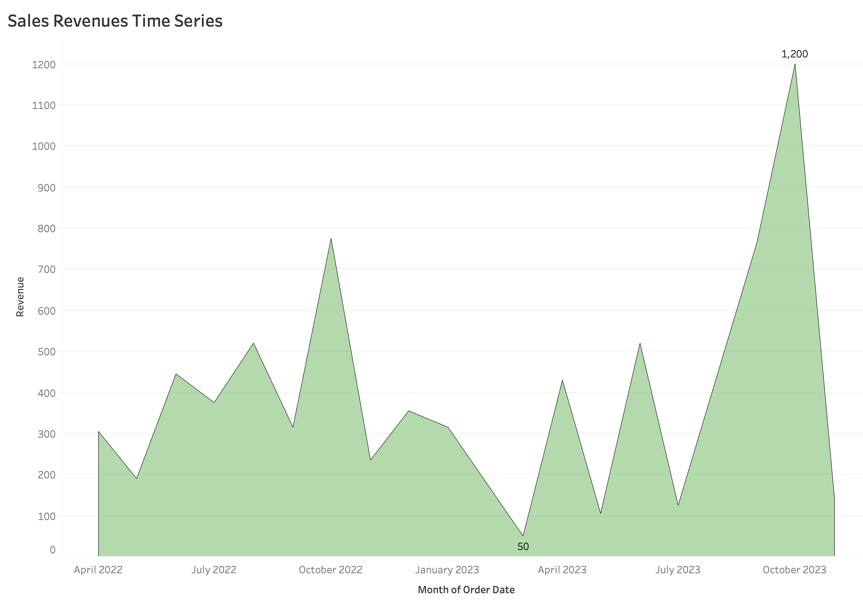

Slide 19
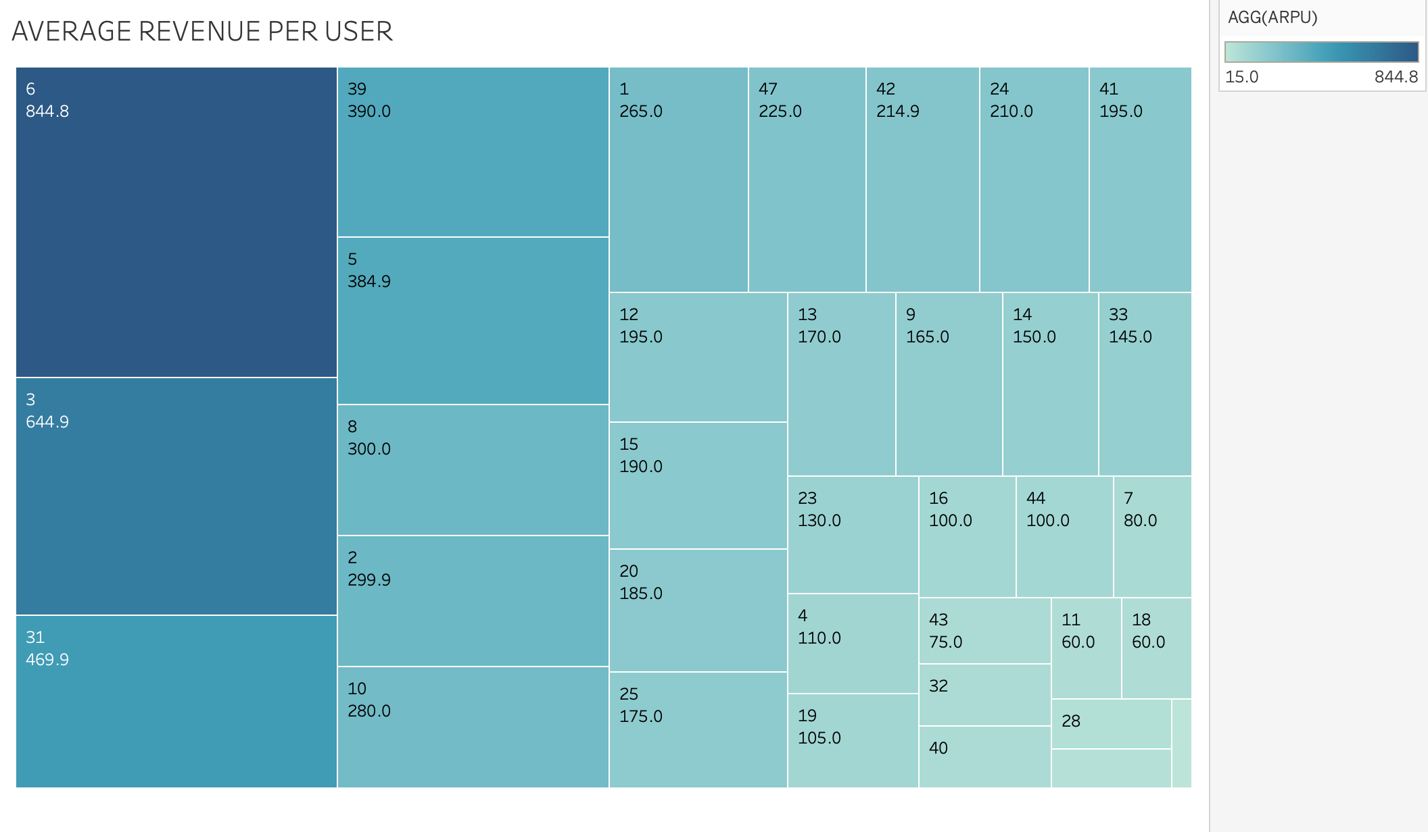

Slide 20
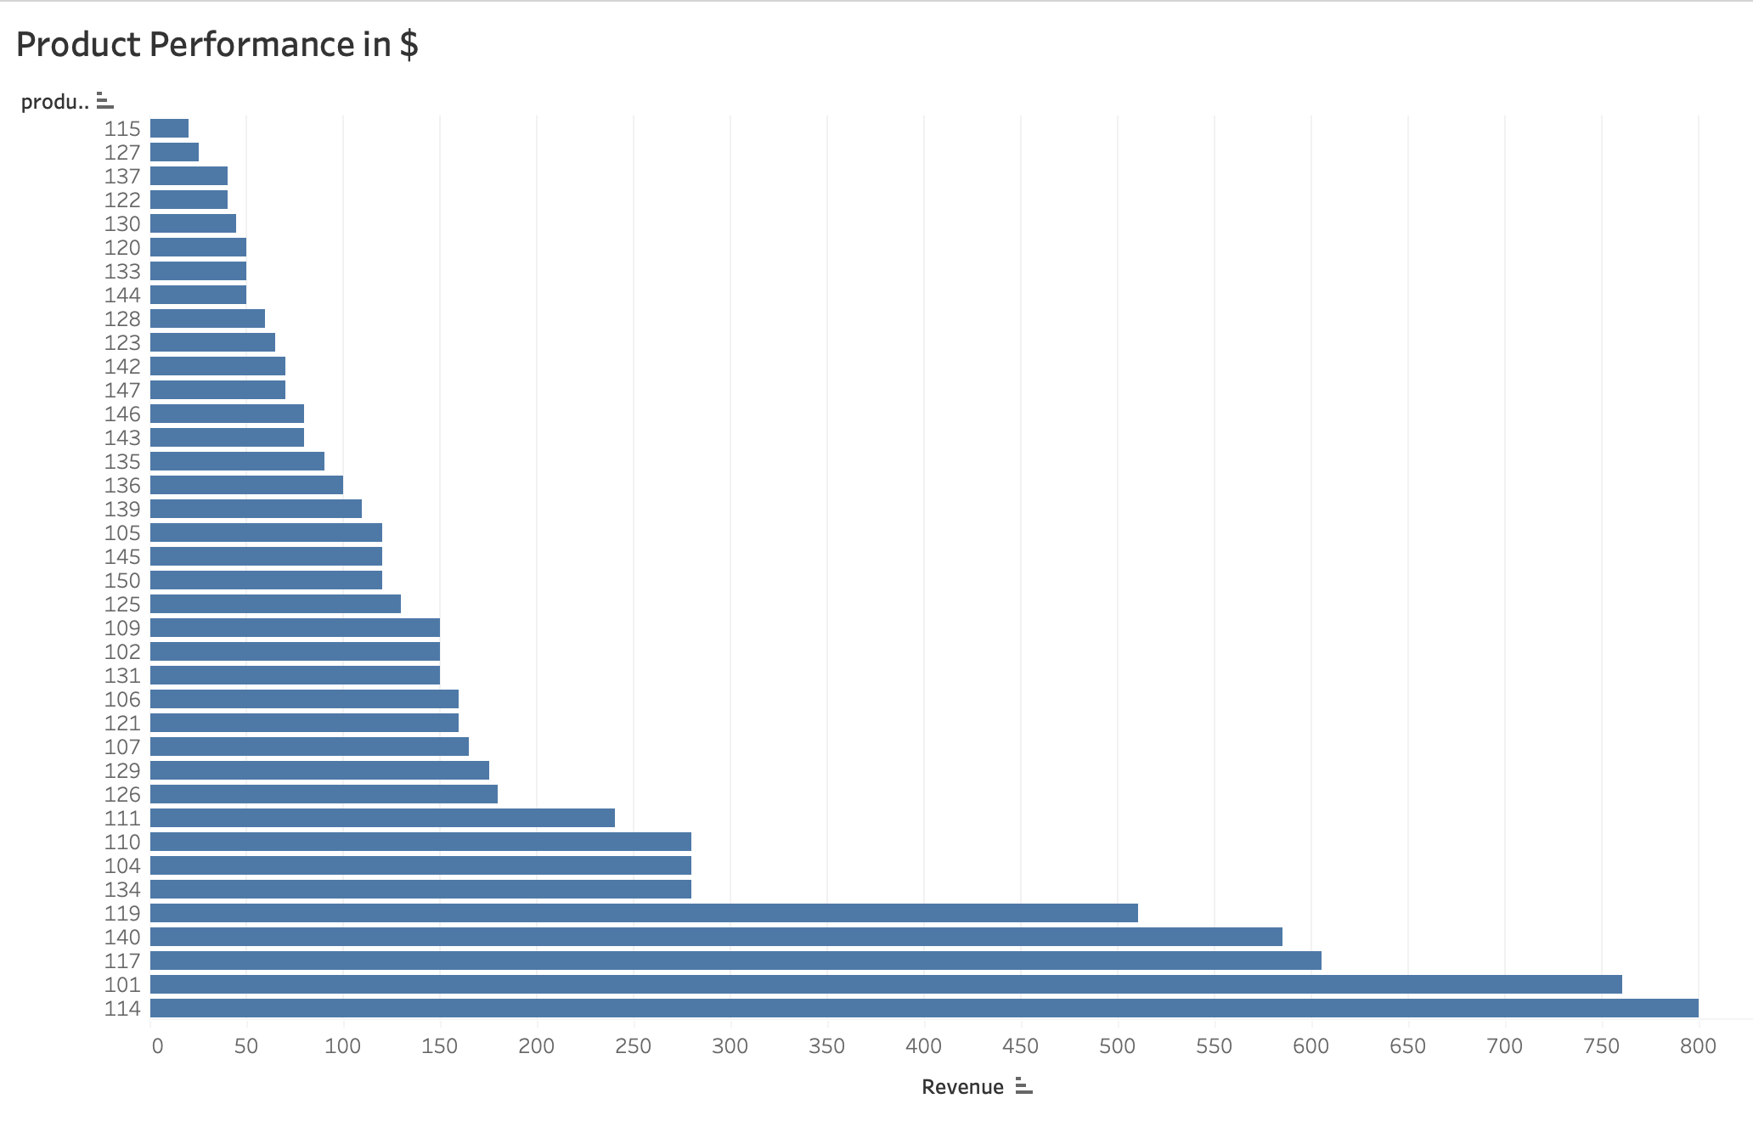

Slide 21
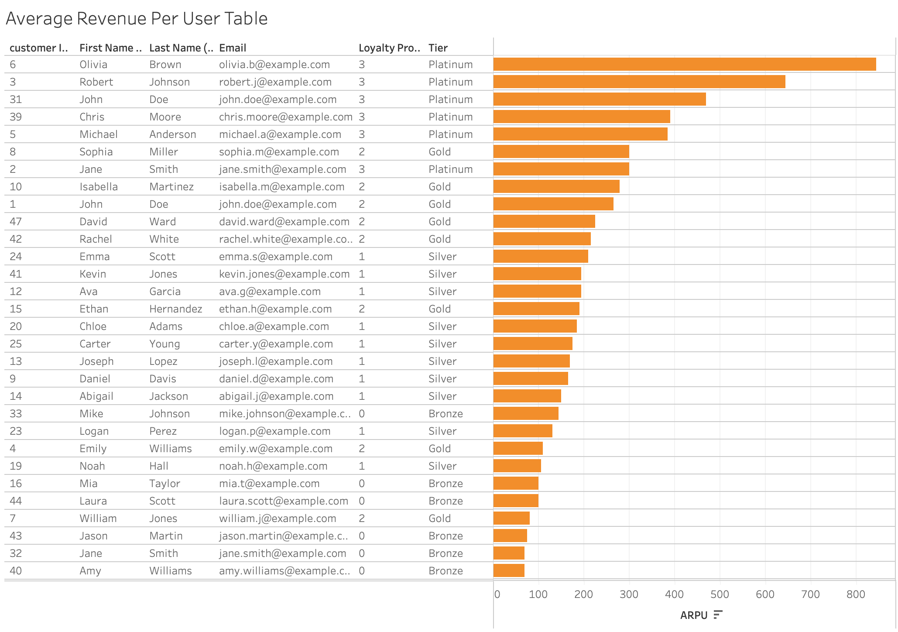

Slide 22
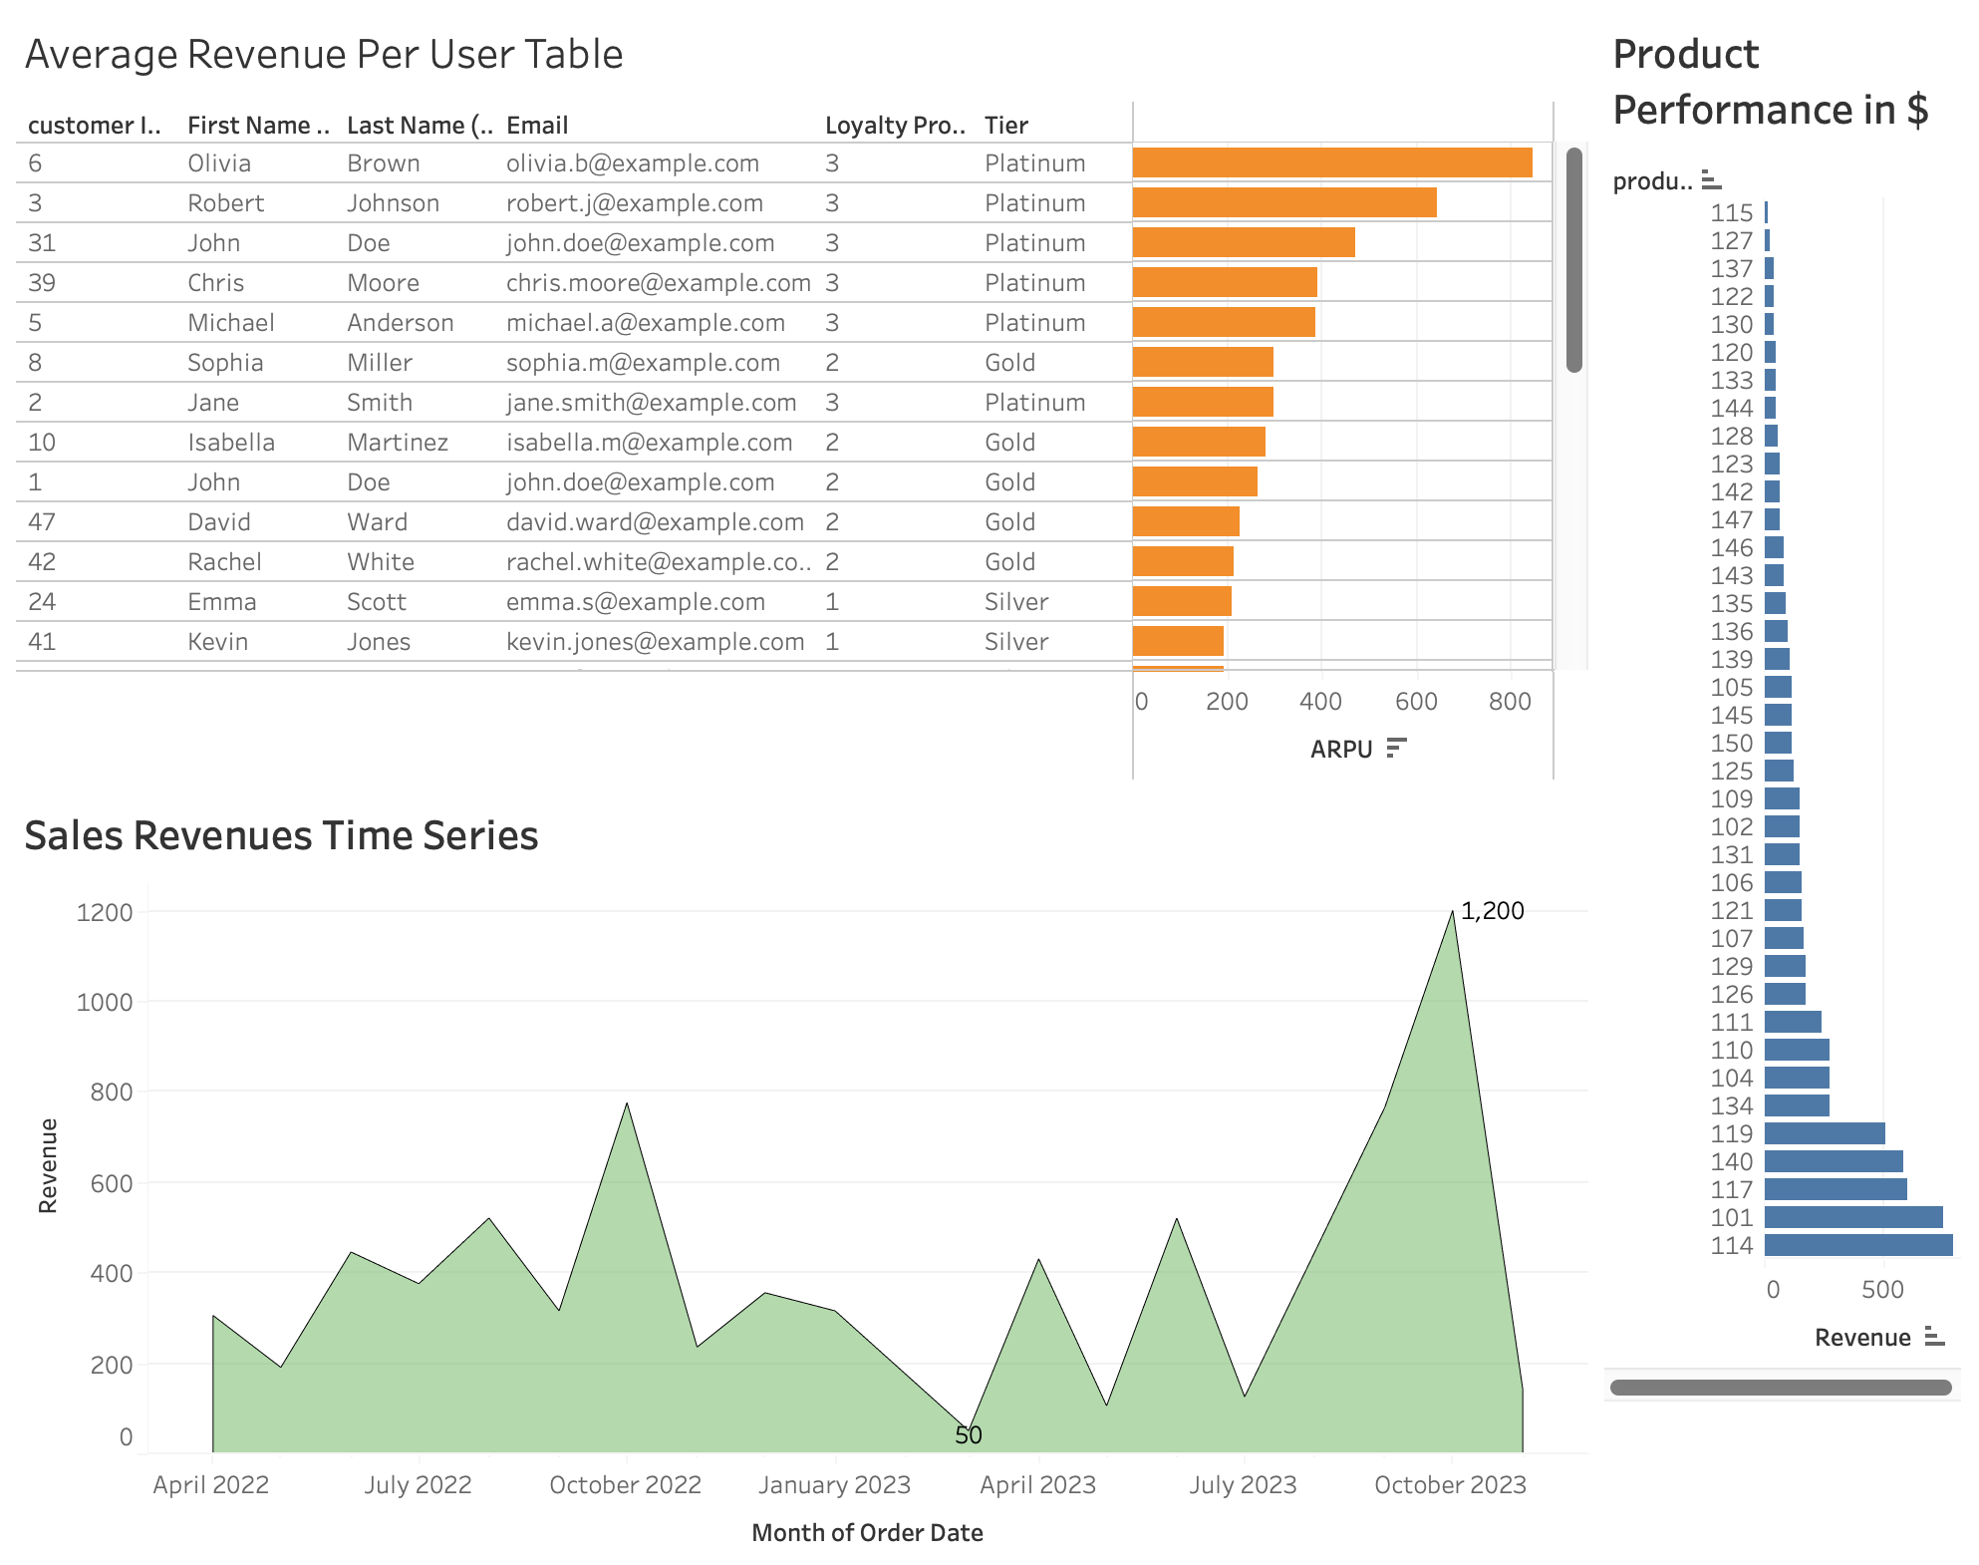
Dashboard 1:

Slide 23
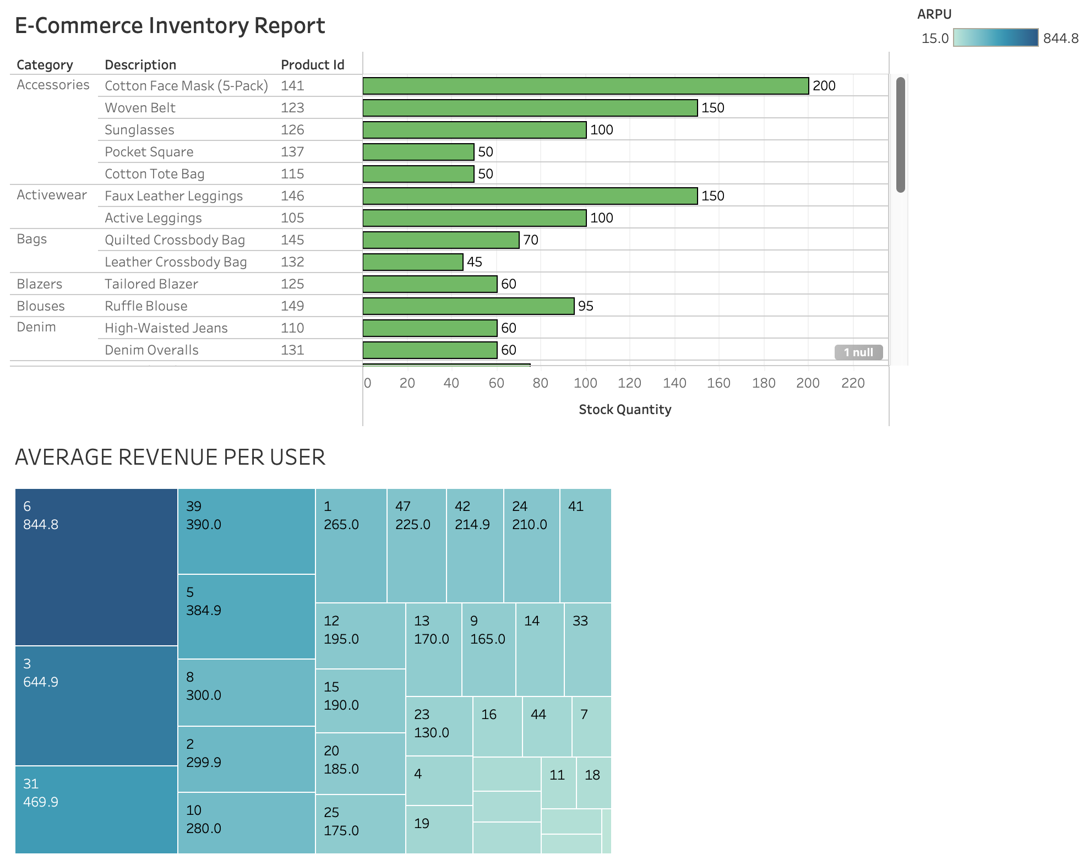
Dashboard 2:

